Slide 1
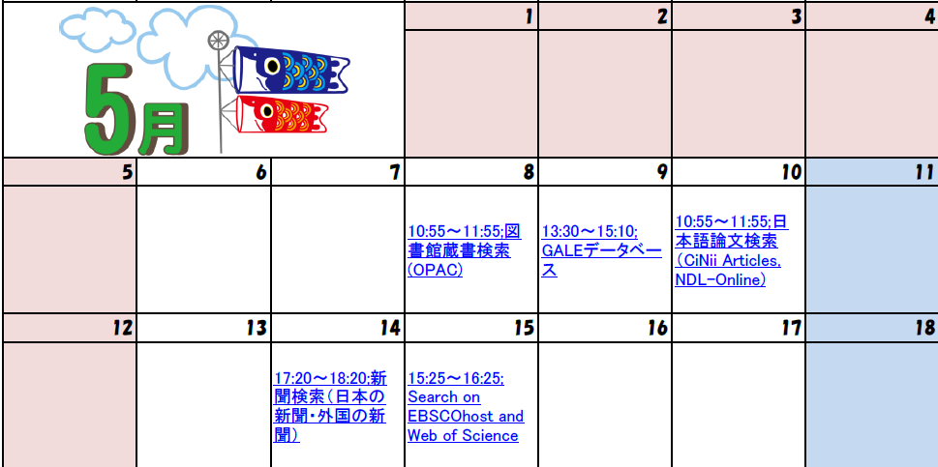
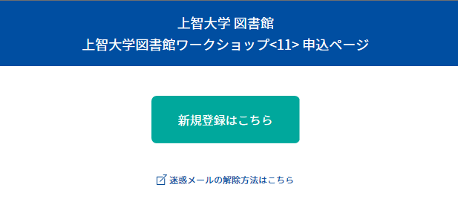
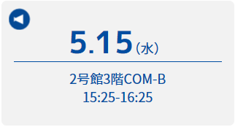
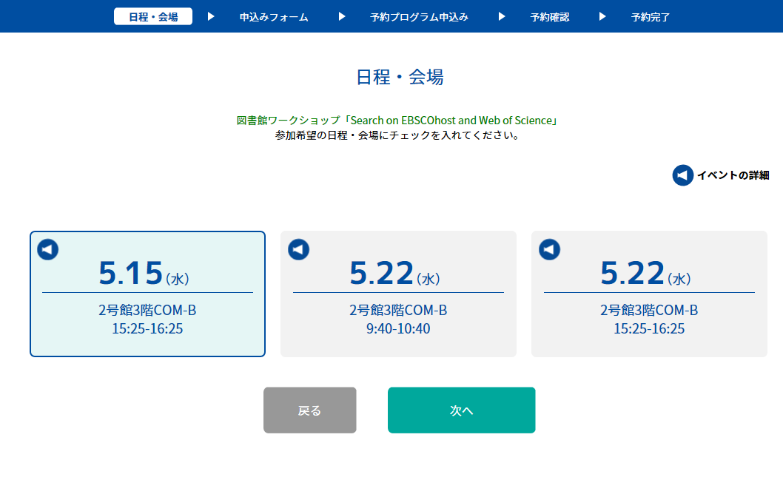
Application procedure
1.Select a workshop
Click on title
2.Fill in the application form
Click here
Details
Date:May 15th
Place:No.2bldg. 3F COM-B
15:25-16:25
Select date and click here

Slide 2
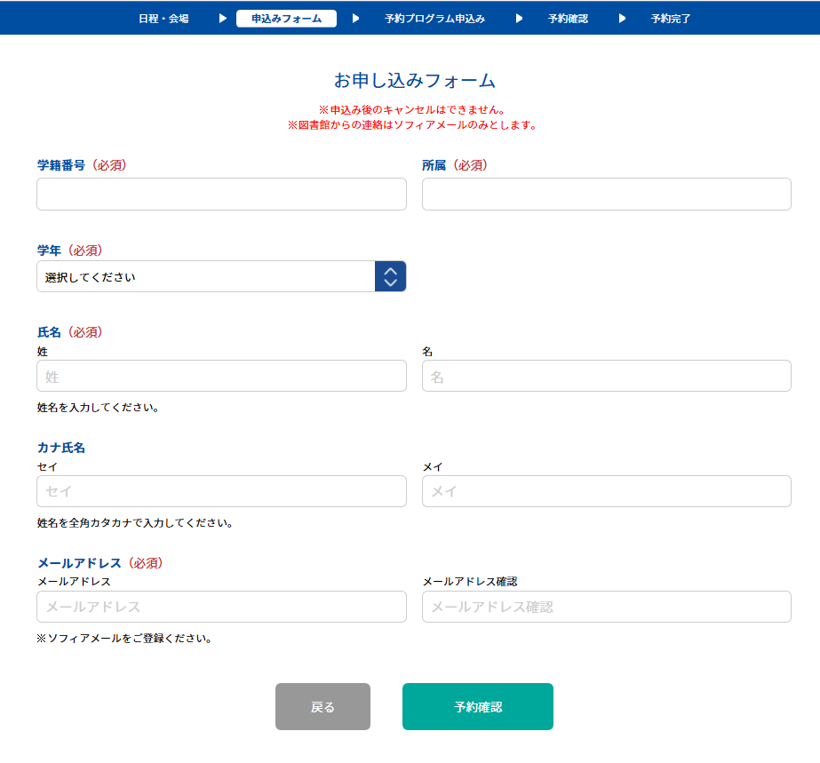
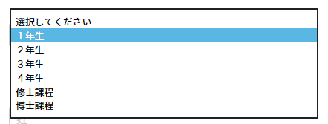
Application Form
ID Number
Faculty
1
2
3
4
Master’s course
Doctor’s course
Grade
Last name
First name
E-mail address(sophia mail)
Mail address(again)
Please click here after completing the application form
You will receive a completion email.(in Japanese)
Please come to the computer room on the day.

